Slide 1
FOR375 Map projections and coordinate systems Spring 2016
Lecture 2 – Map Projections and Coordinate Systems

Slide 2
Map Projections & Coordinate Systems
Models of the Earth
Map Projections & Datums
Map Coordinate Systems
Map Coordinate Systems on USGS Topo Maps
Map Reading & Position Determination
Material from: Bolstad, 2012 (Chpt. 3);

Slide 3
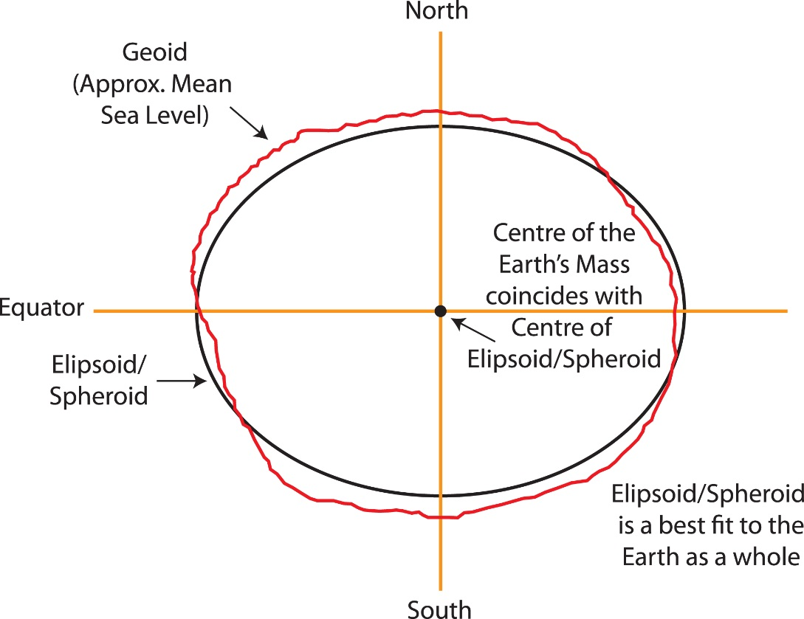
Ellipsoid: mathematical surface obtained by revolving an ellipse about the earth’s polar axis. Selected to give a good fit to the geoid
Geoid: is the earth’s mean sea level surface – everywhere perpendicular to the direction of gravity, because of variations in the earth’s mass distribution, the geoid has an irregular shape.

Slide 4
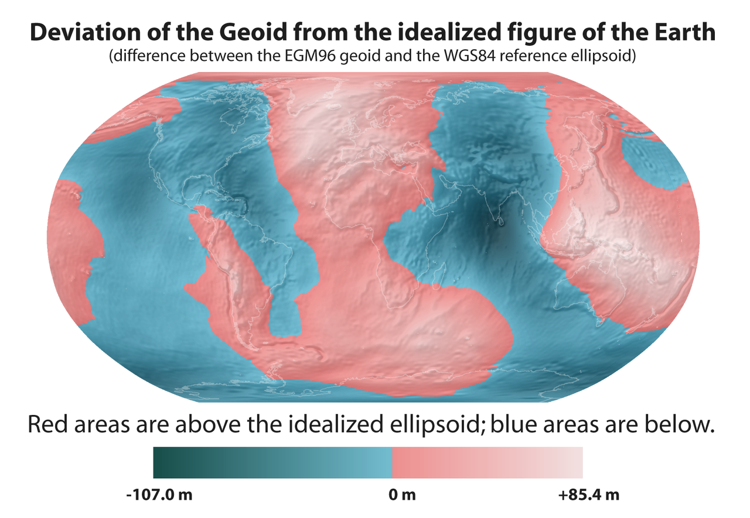

Slide 5
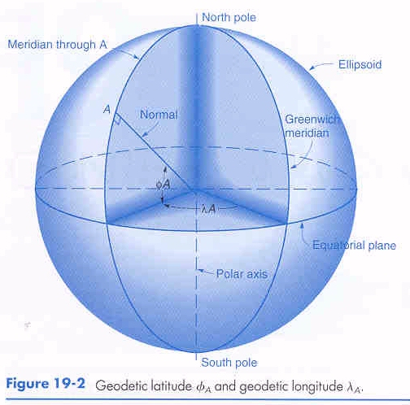
Lines of constant longitude are called meridians
Lines of constant latitude are called parallels
Locations can be defined based on a spherical coordinate in angular units of longitude and latitude

Slide 6
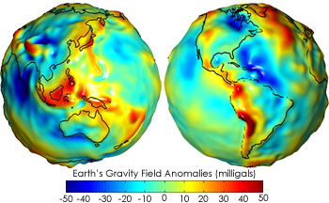
Map Projections & Coordinate Systems
Difficult to use a spherical coordinate system such as a geodetic coordinate system (longitude, latitude) with angular measurements – not intuitive for measuring distances and areas on the earth’s surface.

Slide 7
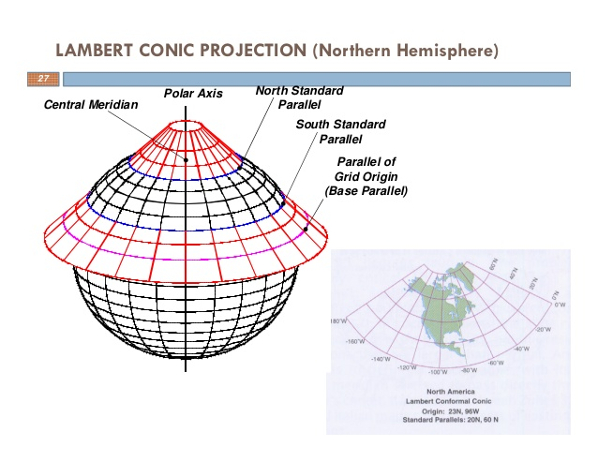
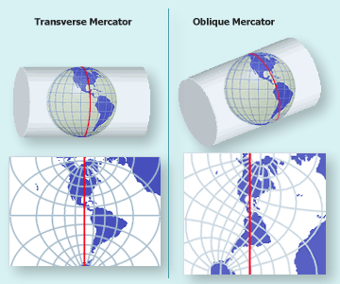
Map Projections: to convert geodetic positions of a portion of the earth’s surface to plane rectangular coordinates, points are projected mathematically from the ellipsoid to some imaginary developable surface - plane that can be rolled out flat
Map Coordinate Systems: quantitative coordinate systems - based on mathematical projection models, often a cartesian coordinate system (i.e. x, y axes) representing relative positions within a particular map projection

Slide 8
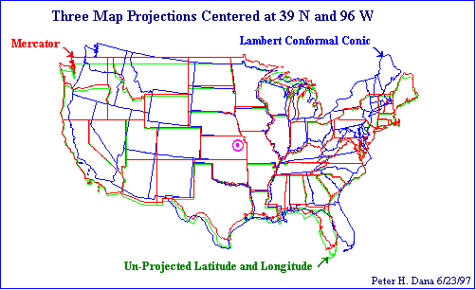

Slide 9
Map Projections & Coordinate Systems
USGS 7.5’ Topographic maps - coordinate systems
Geodetic (geographic): latitude, longitude (deg., min, sec.)
State Plane: easting, northing (feet)
Universal Transverse Mercator: easting, northing (meters)
GLO, U.S. Public Land Survey: Township, Range, Section

Slide 10
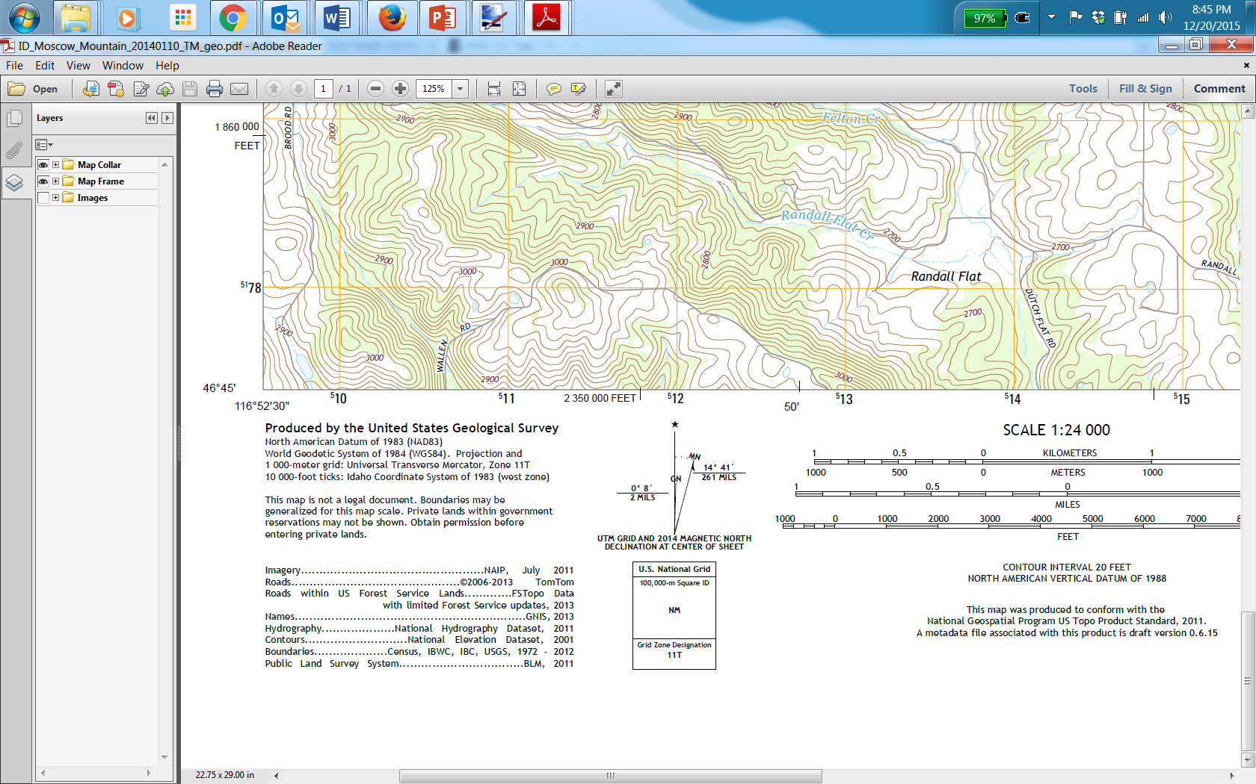
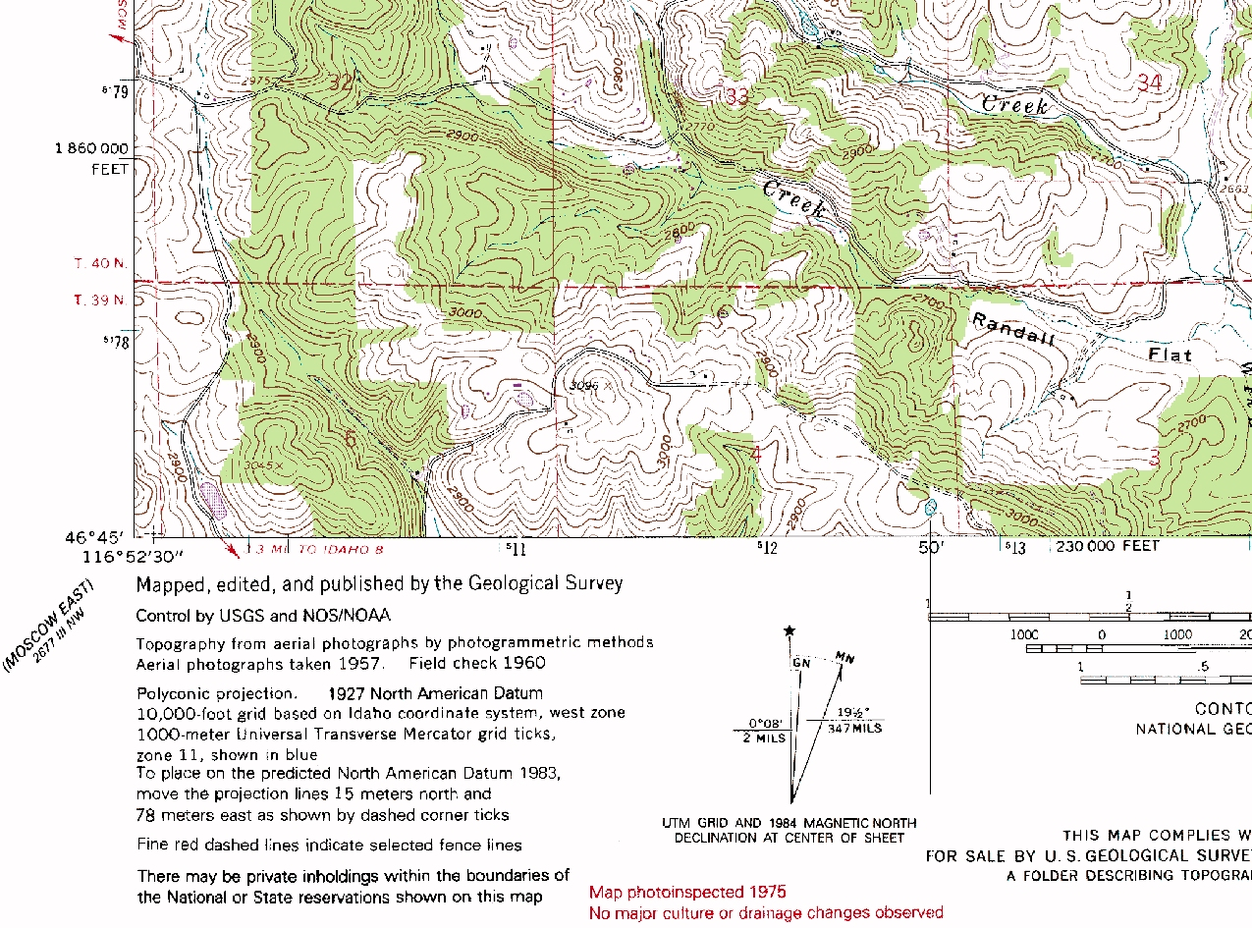

Slide 11
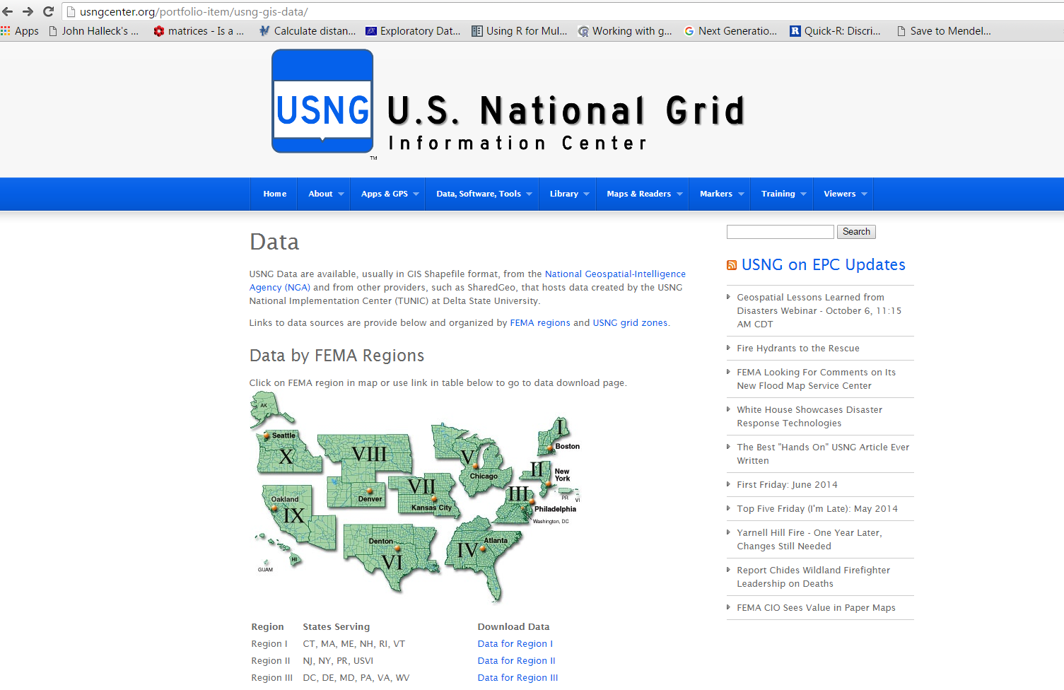

Slide 12
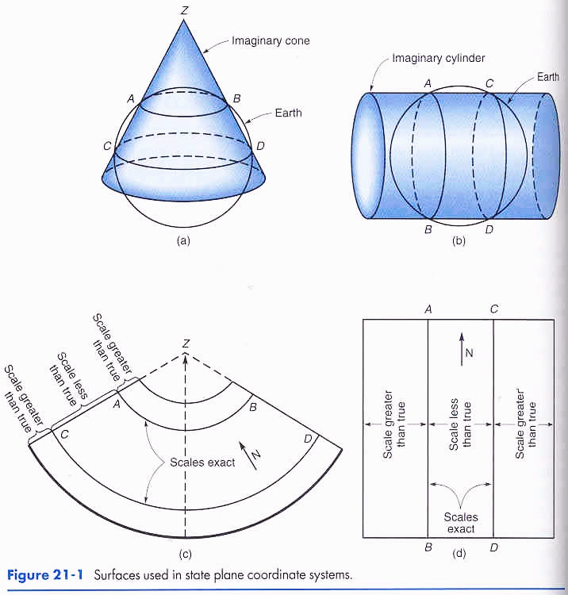
Map projections use different models for converting the ellipsoid to a rectangular coordinate system.
Each generates distortions in scale and shape of objects.
Lambert Conformal Conic Projection, scales vary N-S,E-W oriented states: Penn, Tenn (31 states)
Transverse Mercator Projection, scales vary E-W, N-S oriented states; Ill, Ind, Idaho (22 states)

Slide 13
Map Projections & Coordinate Systems
USGS 7.5’ Topographic maps - coordinate systems
Geodetic (geographic): latitude, longitude (deg., min, sec.) State Plane: easting, northing (feet) Universal Transverse Mercator: easting, northing (meters) GLO, U.S. Public Land Survey: Township, Range, Section

Slide 14
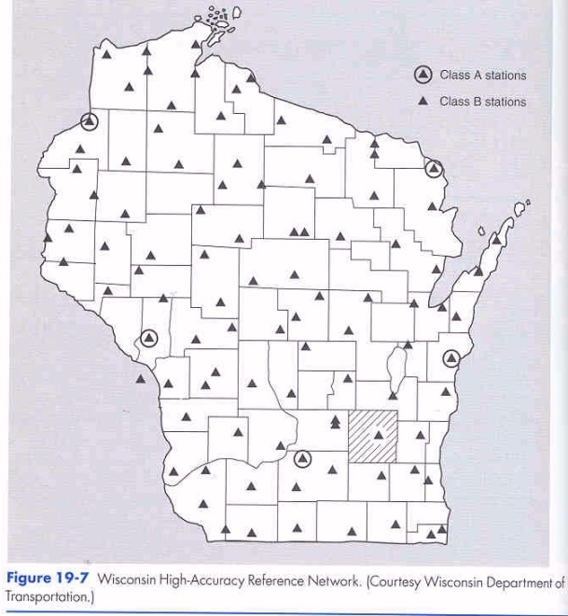
Reference datums (horizontal, vertical) – US Geodetic Survey
Horizontal and vertical datums consist of a network of control monuments and bench marks whose horizontal positions and elevations have been determined by precise geodetic control surveys.
NAD 27 - Clarke ellipsoid (1866), Meades Ranch – origin (25k pt)
NAD 83 - GRS - 80 ellipsoid, Earth’s mass center (270k pts)
WGS 84
NGVD29 (26 sea level gauging stations US & Canada)
NAVD88 (625k km of control leveling, crustal movements..)
Control point networks exist as known points with ground monuments (benchmarks) around the world

Slide 15

Map Projections and coordinate systems – Datum Transformations
Datum transformations account for differences in geographic coordinates due to changes in the shape or origin of the spheroid/ellipsoid, and in some cases datum adjustments.
Map projections are usually considered exact transformations because they are based on a specific mathematical formula (although some empirically based map projections also exist). Datum transformations are considered empirical (based on measurement) because they are based on “data” or survey points

Slide 16
North American Datum of 1927 (NAD 27) is "The horizontal control datum for the United States that was defined by a single location and azimuth on the Clarke spheroid of 1866, with origin at (the survey station) Meades Ranch." ... The geoidal height at Meades Ranch was assumed to be zero. "Geodetic positions on the North American Datum of 1927 were derived from the (coordinates of and an azimuth at Meades Ranch) through a readjustment of the triangulation of the entire network in which Laplace azimuths were introduced, and the Bowie method was used.“
The North American Datum of 1983 (NAD 83) is the horizontal control datum for the United States, Canada, Mexico, and Central America, based on a geocentric origin and the Geodetic Reference System 1980.This datum, NAD 83, is the current geodetic reference system. NAD 83 is based on the adjustment of 250,000 points, including 600 satellite Doppler stations, which constrain the system to a geocentric origin.

Slide 17
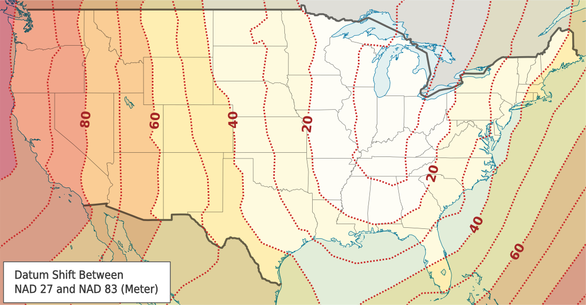
When transforming from one map projection to another that includes a datum change, it’s usually best to first transform back to Geographic coordinates first, then re-project. See Bolstad Fig. 3-47

Slide 18
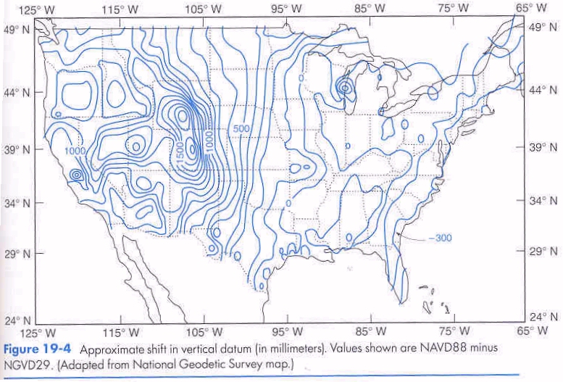

Slide 19
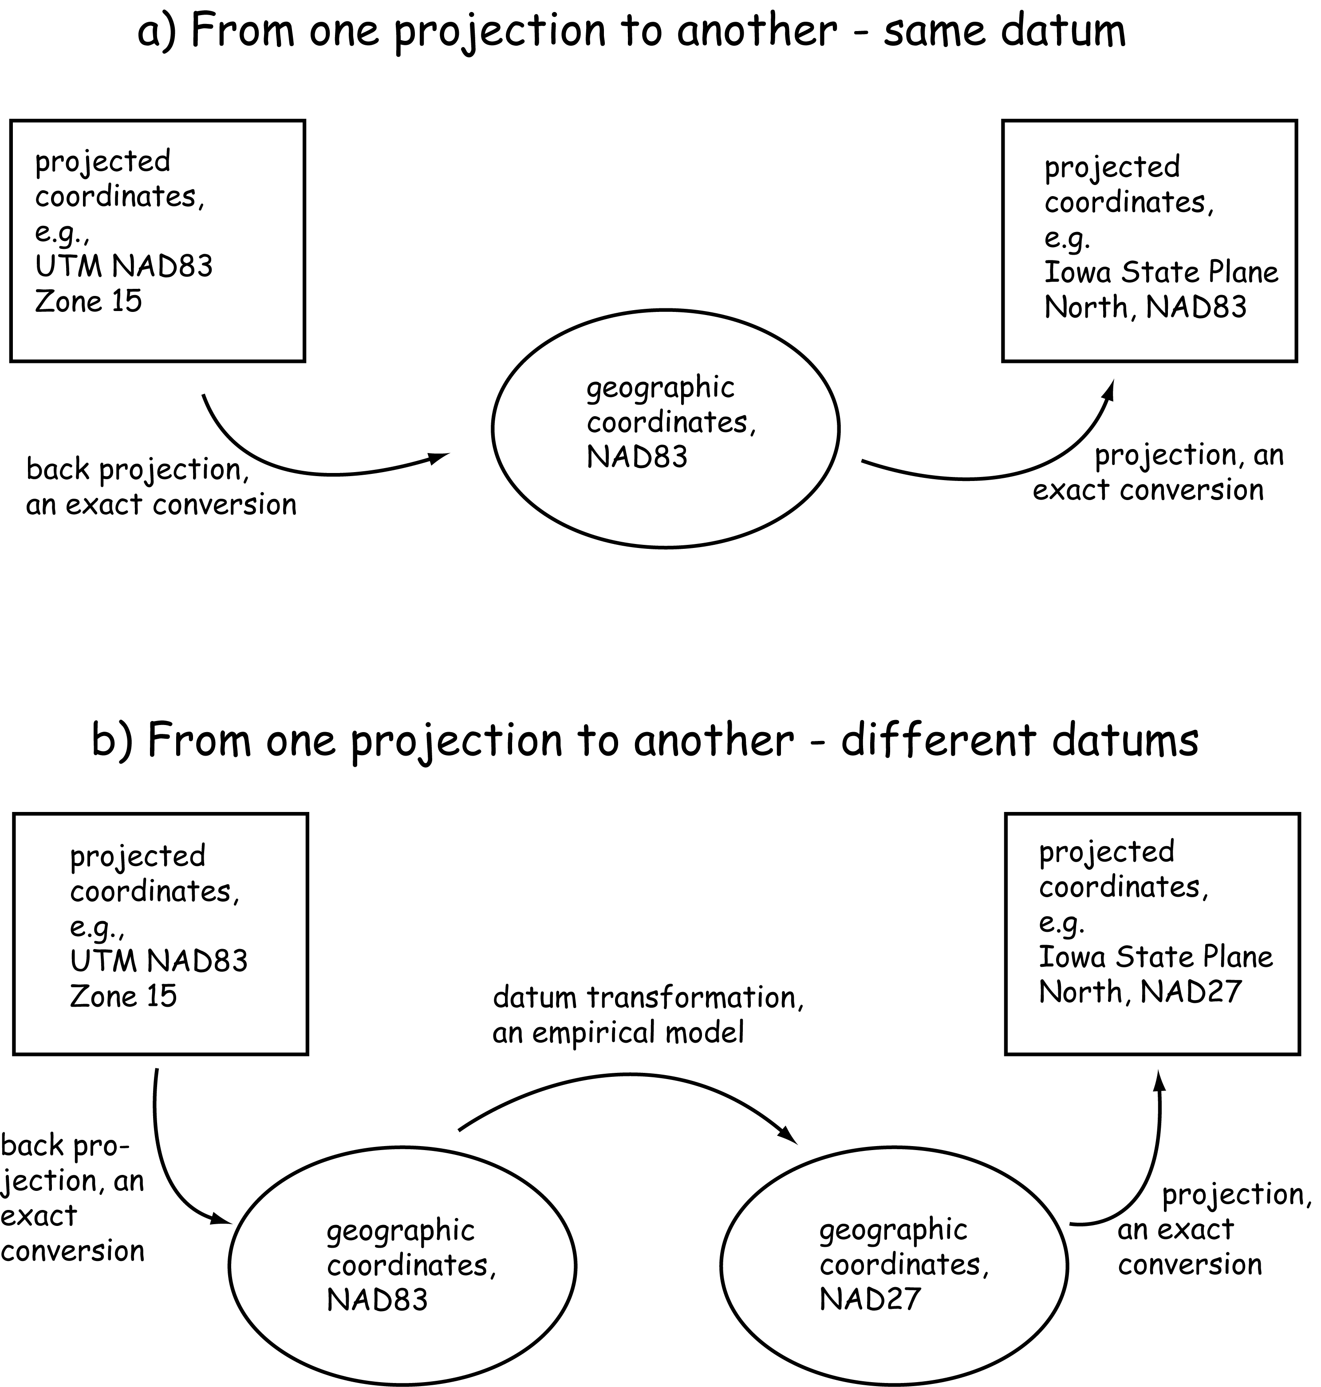

Slide 20
Map Projections & Coordinate Systems
USGS 7.5’ Topographic maps - coordinate systems
Geodetic (geographic): latitude, longitude (deg., min, sec.) State Plane: easting, northing (feet) Universal Transverse Mercator: easting, northing (meters) GLO, U.S. Public Land Survey: Township, Range, Section

Slide 21
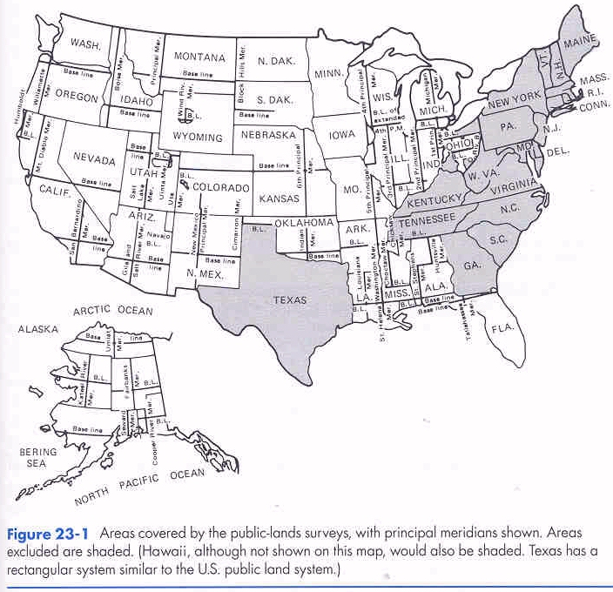
State Plane
Individual states establish a baseline and meridian specific to the needs of that state (English Units – foot)
Idaho: Boise meridian, baseline - Boise

Slide 22
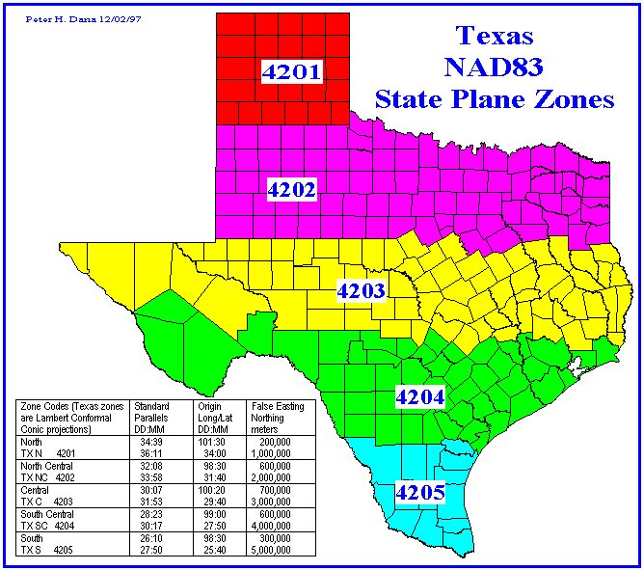
State Plane
Map Projections & Coordinate Systems

Slide 23
Map Projections & Coordinate Systems
USGS 7.5’ Topographic maps - coordinate systems
Geodetic (geographic): latitude, longitude (deg., min, sec.) State Plane: easting, northing (feet) Universal Transverse Mercator: easting, northing (meters) GLO, U.S. Public Land Survey: Township, Range, Section

Slide 24
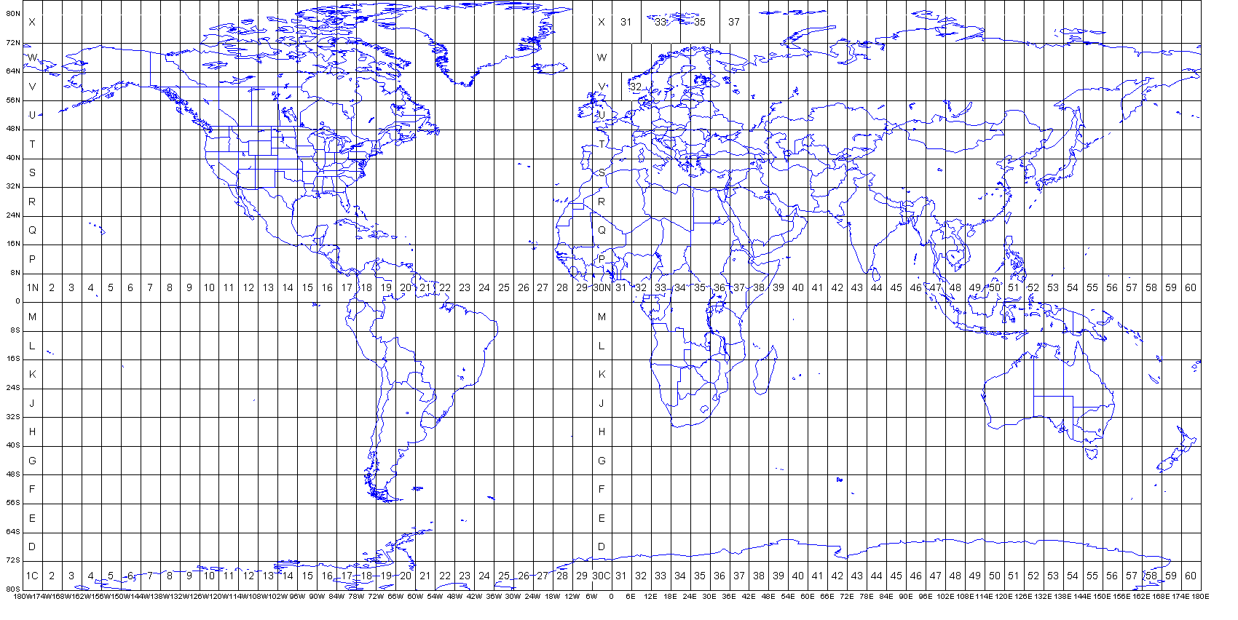
Map Projections & Coordinate Systems
UTM
Universal Transverse Mercator coordinate system: worldwide coverage from 80º S lat to 84º N lat.
Each zone is 6 º wide in longitude, 60 zones worldwide
US UTM zones 10 (west coast) - 20 (east coast)

Slide 25
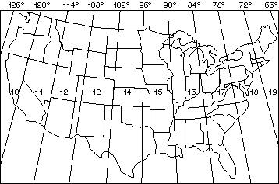
Universal Transverse Mercator (UTM) Map Projection
In Idaho, we use the Boise Central Meridian (117º Long.) for all easting coordinates, and a false easting is added so that all UTM easting coordinates are positive within zone 11. Idaho UTM more recently established.

Slide 26
Map Projections & Coordinate Systems
USGS 7.5’ Topographic maps - coordinate systems
Geodetic (geographic): latitude, longitude (deg., min, sec.) State Plane: easting, northing (feet) Universal Transverse Mercator: easting, northing (meters) GLO, U.S. Public Land Survey: Township, Range, Section

Slide 27
Map Projections & Coordinate Systems, US Public land survey
Rectangular: US PLSS
The two major systems of legal land description used in the United States are: (1) metes and bounds and (2) rectangular survey system.
The metes and bounds system was used in areas settled when the U.S. was still a colony of England.
This system located tracts of land by describing the tract location to roads, trees, rocks, meanders or waterways, etc.

Slide 28
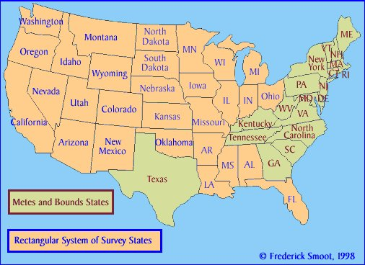

Slide 29
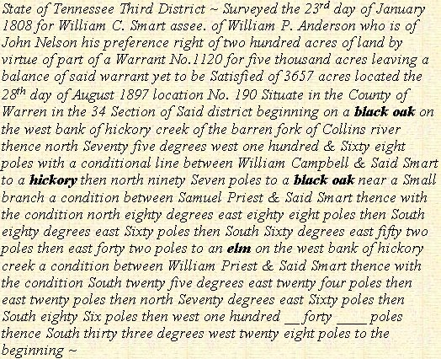
Irregularly shaped tracts and loss of markers as time passes may cause many boundary disputes under this system.
In 1784, the US adopted the rectangular survey system, which is used in 30 of the 50 states. This system is based on meridians (north-south lines) and baselines (east-west lines). There are 34 "principal meridians" in the United States; each has a baseline associated with it.

Slide 30
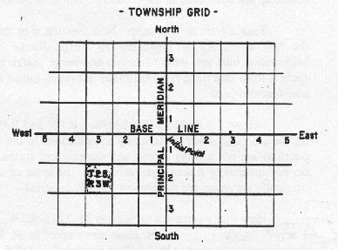
Rectangular: US PLSS
Map Projections & Coordinate Systems
Tracts of land, called townships, are laid out beginning from the point where the meridian crosses its baseline (initial point). Townships are as close to 6 miles square as possible.
T2S, R3W
6 mi.

Slide 31
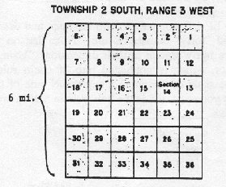
Rectangular: US PLSS
Map Projections & Coordinate Systems
The sections are numbered from 1 to 36, beginning in the northeast corner. Each 1-mile square section contains “nominally” 640 acres.
Section 14, T2S, R3W

Slide 32
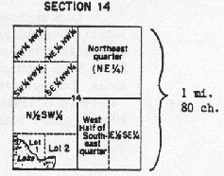
Rectangular: US PLSS
Map Projections & Coordinate Systems
Areas smaller than a section are broken down into quarters of sections or sometimes halves of sections. These tracts may then be further broken into quarters or halves.
SE 1/4, NW 1/4, Section 14, T2S, R3W

Slide 33
Red lines on our 7.5’ topo maps represent section lines. Red cross at the corners indicates there is a section corner monument in the ground (if topo map is up-to-date)

Slide 34
Map Projections & Coordinate Systems
What you should know:
ellipsoids fit to the earth geoid are used to create a model of the earth
map projections are used to mathematically project the ellipsoid onto a planar surface or flat map
we use reference datums and ground control networks with monuments to connect real world locations to these map projections and ellipsoids
what projections and coordinate systems (4) exist on our 7.5 minute topographic maps
use any of these map coordinate systems to determine a position on our Moscow Mt. topographic map

